Slide 1
Design Data Intensive Application

Slide 2
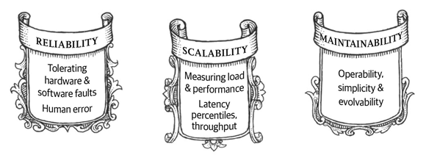
What we need for Big Data

Slide 3
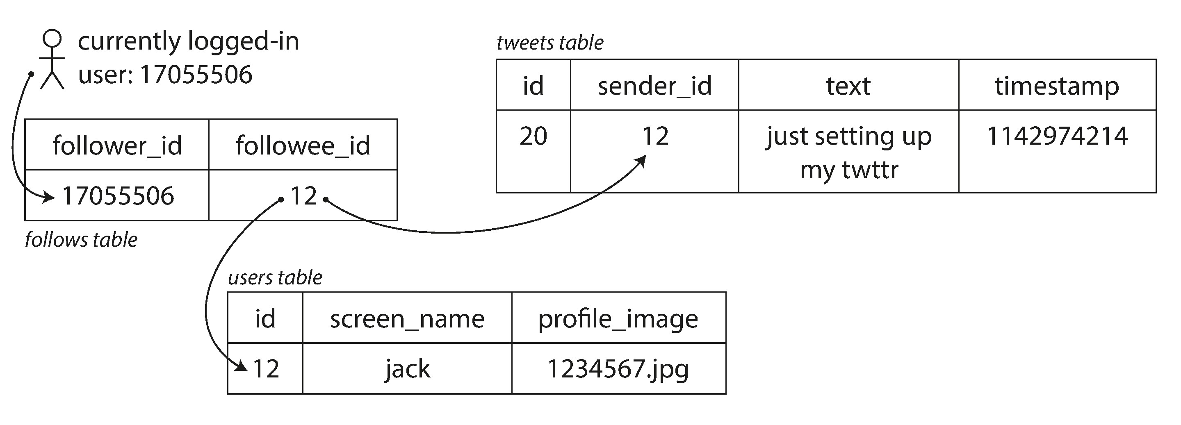
Relational Model
An example of Tweet
We need join to get the whole picture of the data.

Slide 4
Relational Data Model

Slide 5
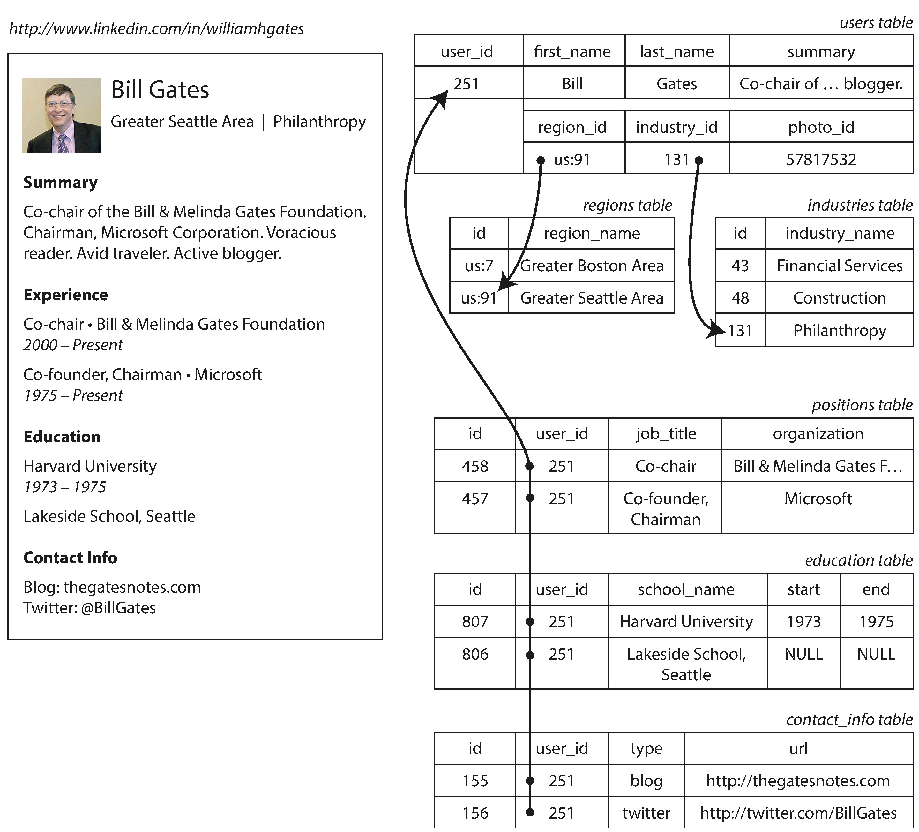
Document Model
A LinkedIn Profile

Slide 6
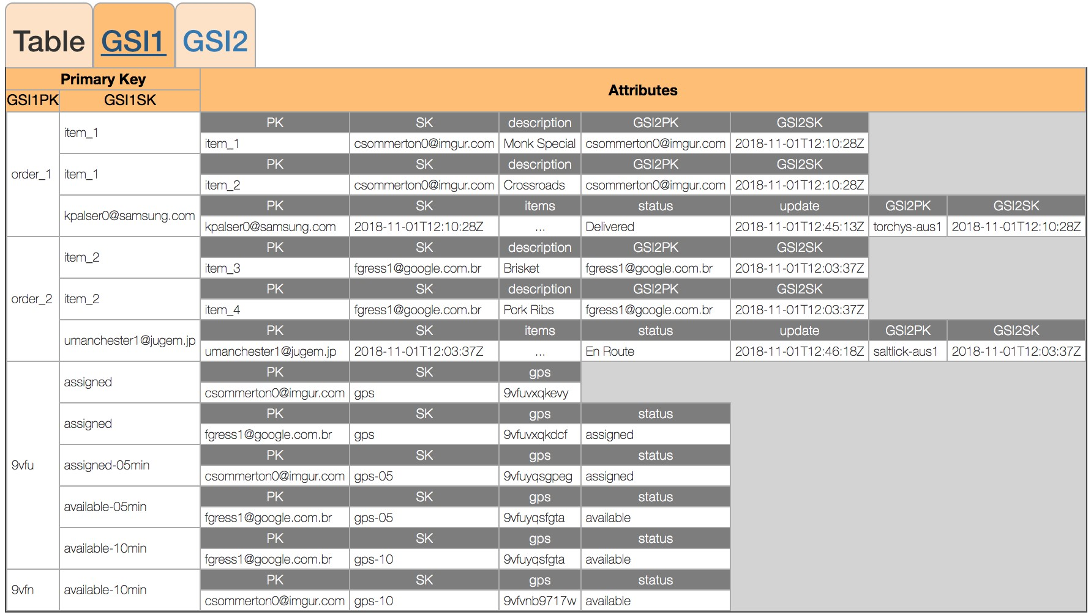
No SQL Data Model

Slide 7
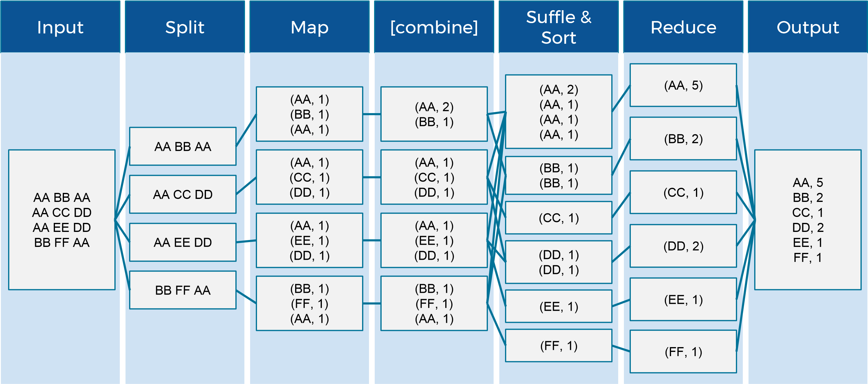
Map Reduce

Slide 8
Key Ideas between RDB and Non-SQL
 | Relation Database | Cloud
Data Integrity | Enforced, such as foreign key reference, no empty, unique, value range | Normally not enforced
Data Normalization | Follow 1st , 2nd , 3rd NF, sometime BNF | Denormalized, data duplicated and keep local
Transactional | Strong consistency | CAP, tunable consistency or eventually consistency
Recovery | Auto backup, transactional log, restart for recovery. | Fall back to replicas

Slide 9
Storage and Retrieval

Slide 10
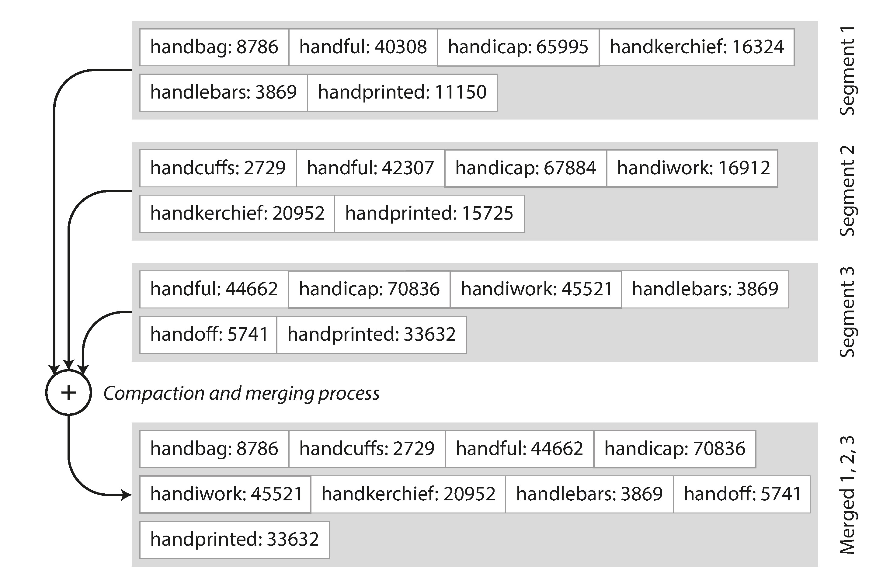
Sorted String Tables(SSTables)

Slide 11
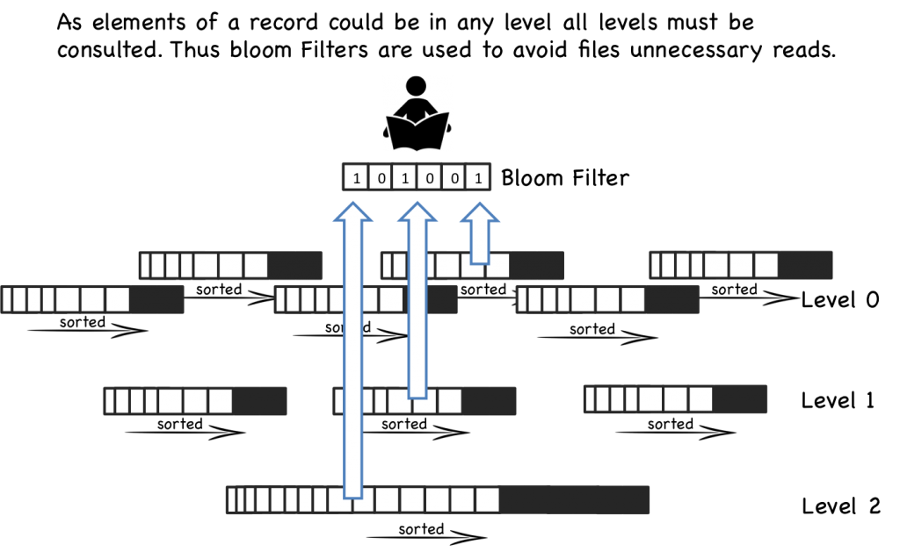
Data can be at any level of LSM tree

Slide 12
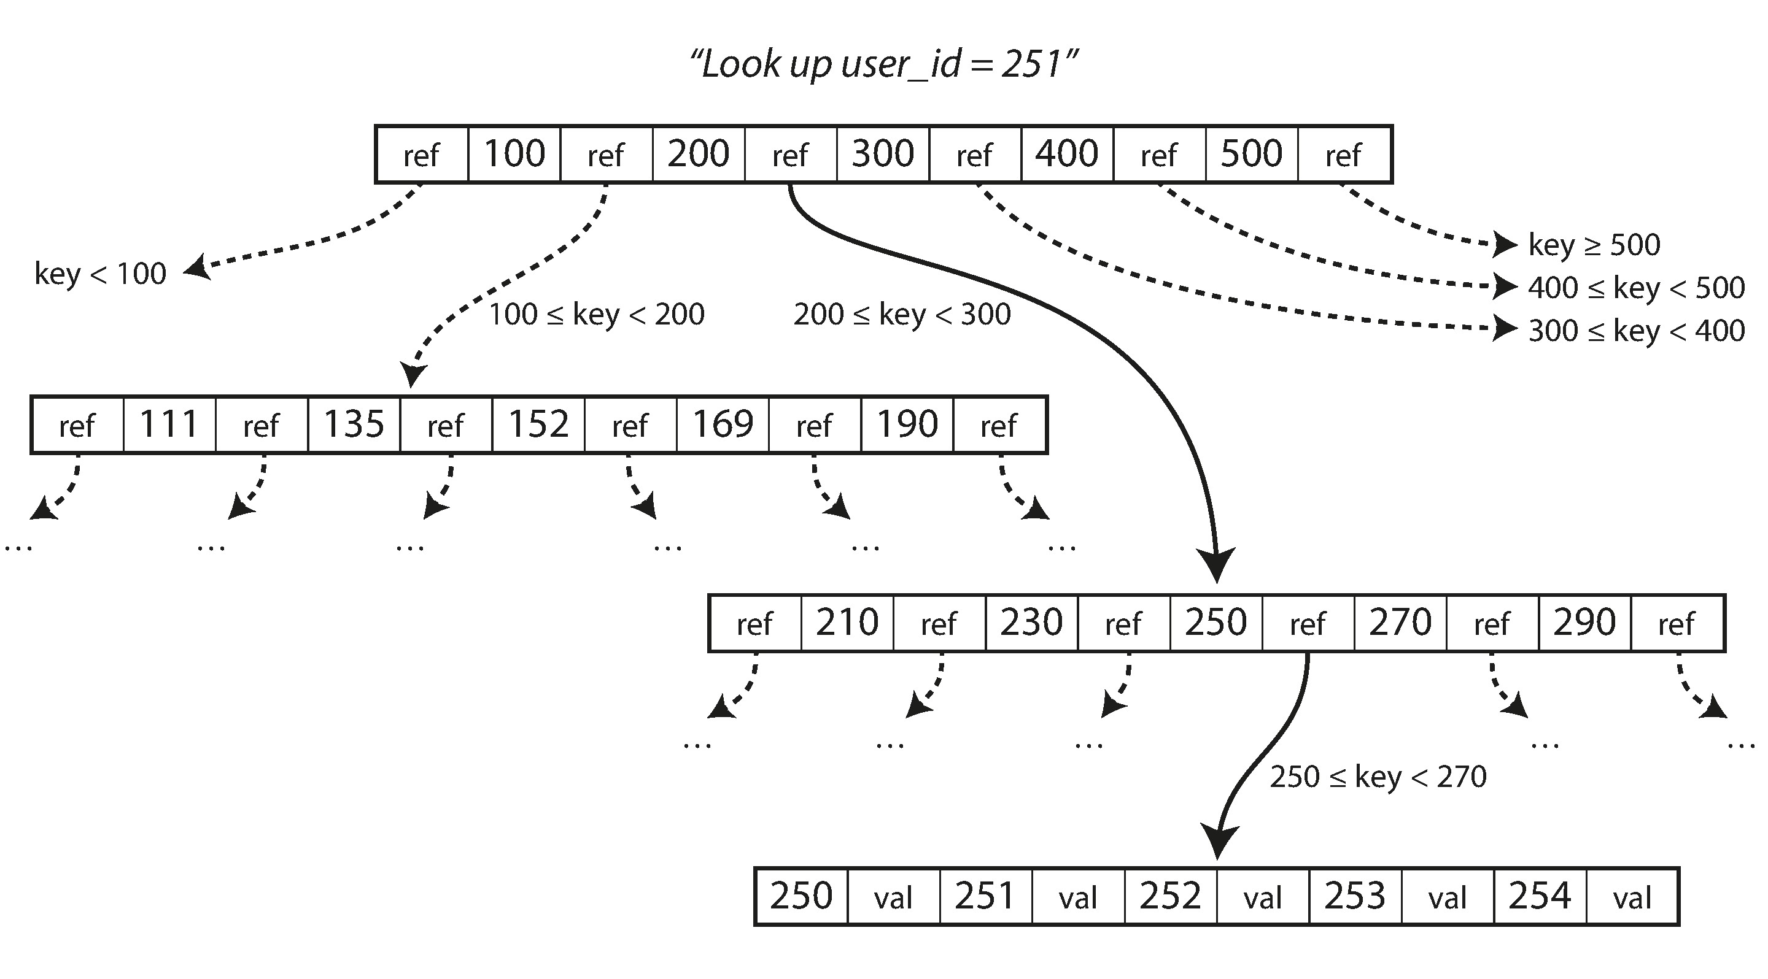
B-Trees

Slide 13
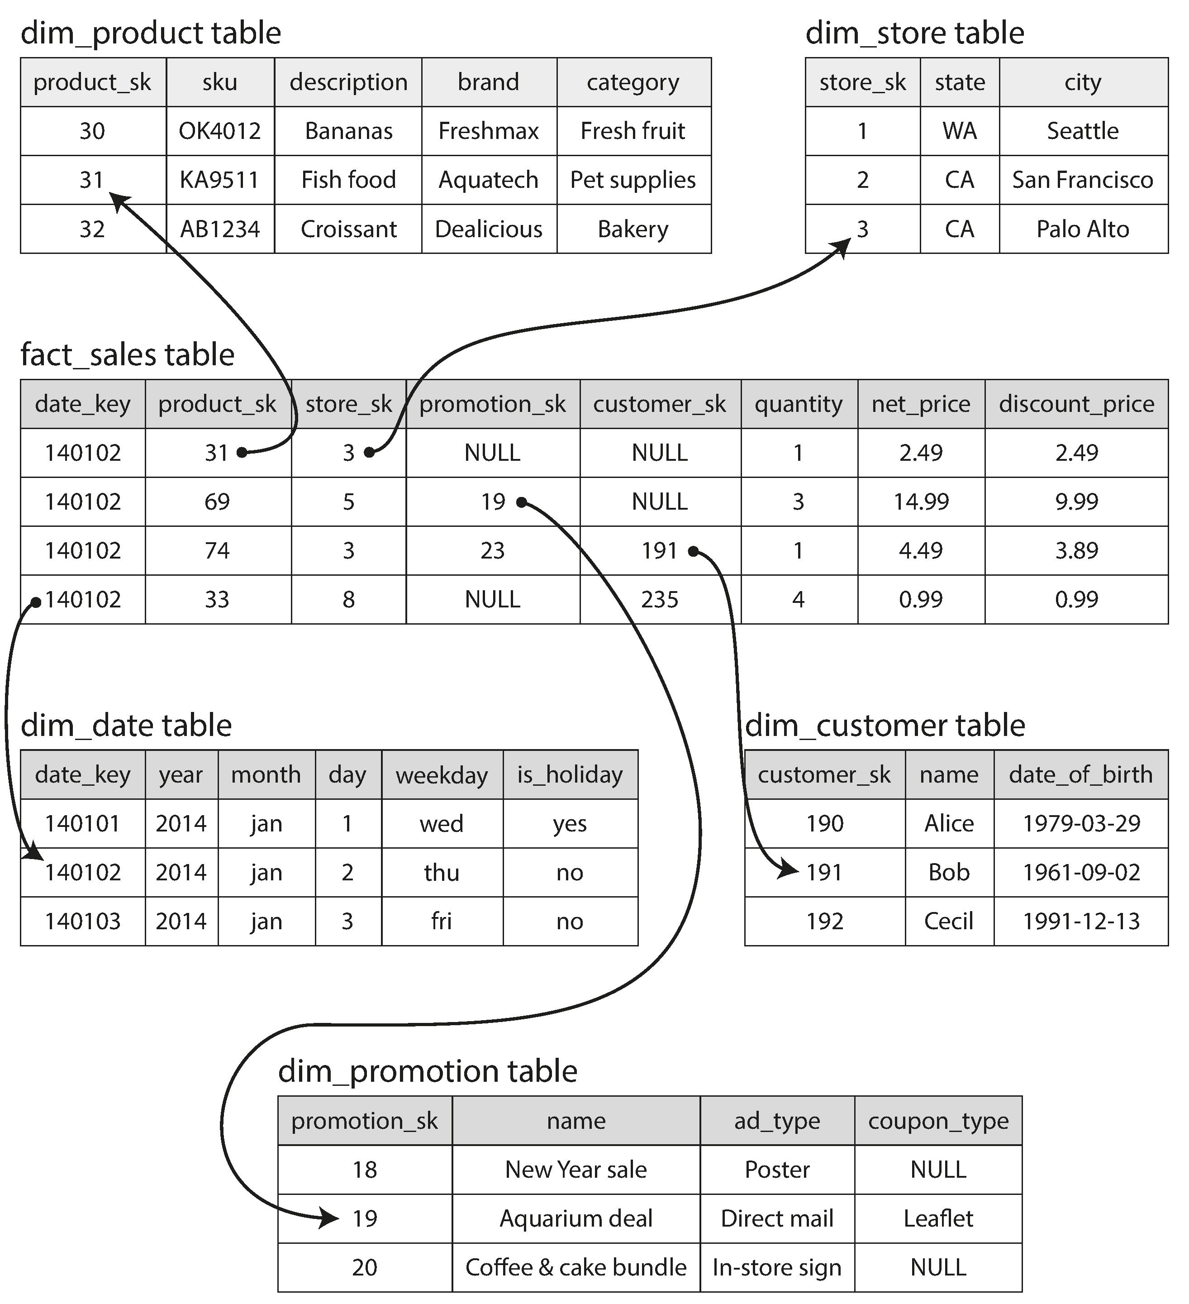
Star Schema for Analytics

Slide 14
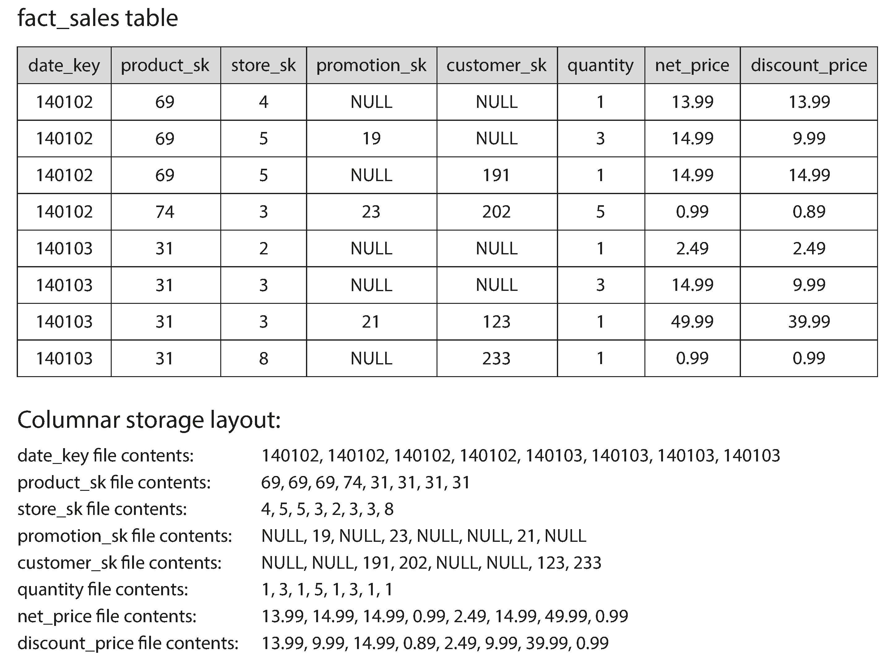
Column Store
* In every analytics query we only select very few columns

Slide 15
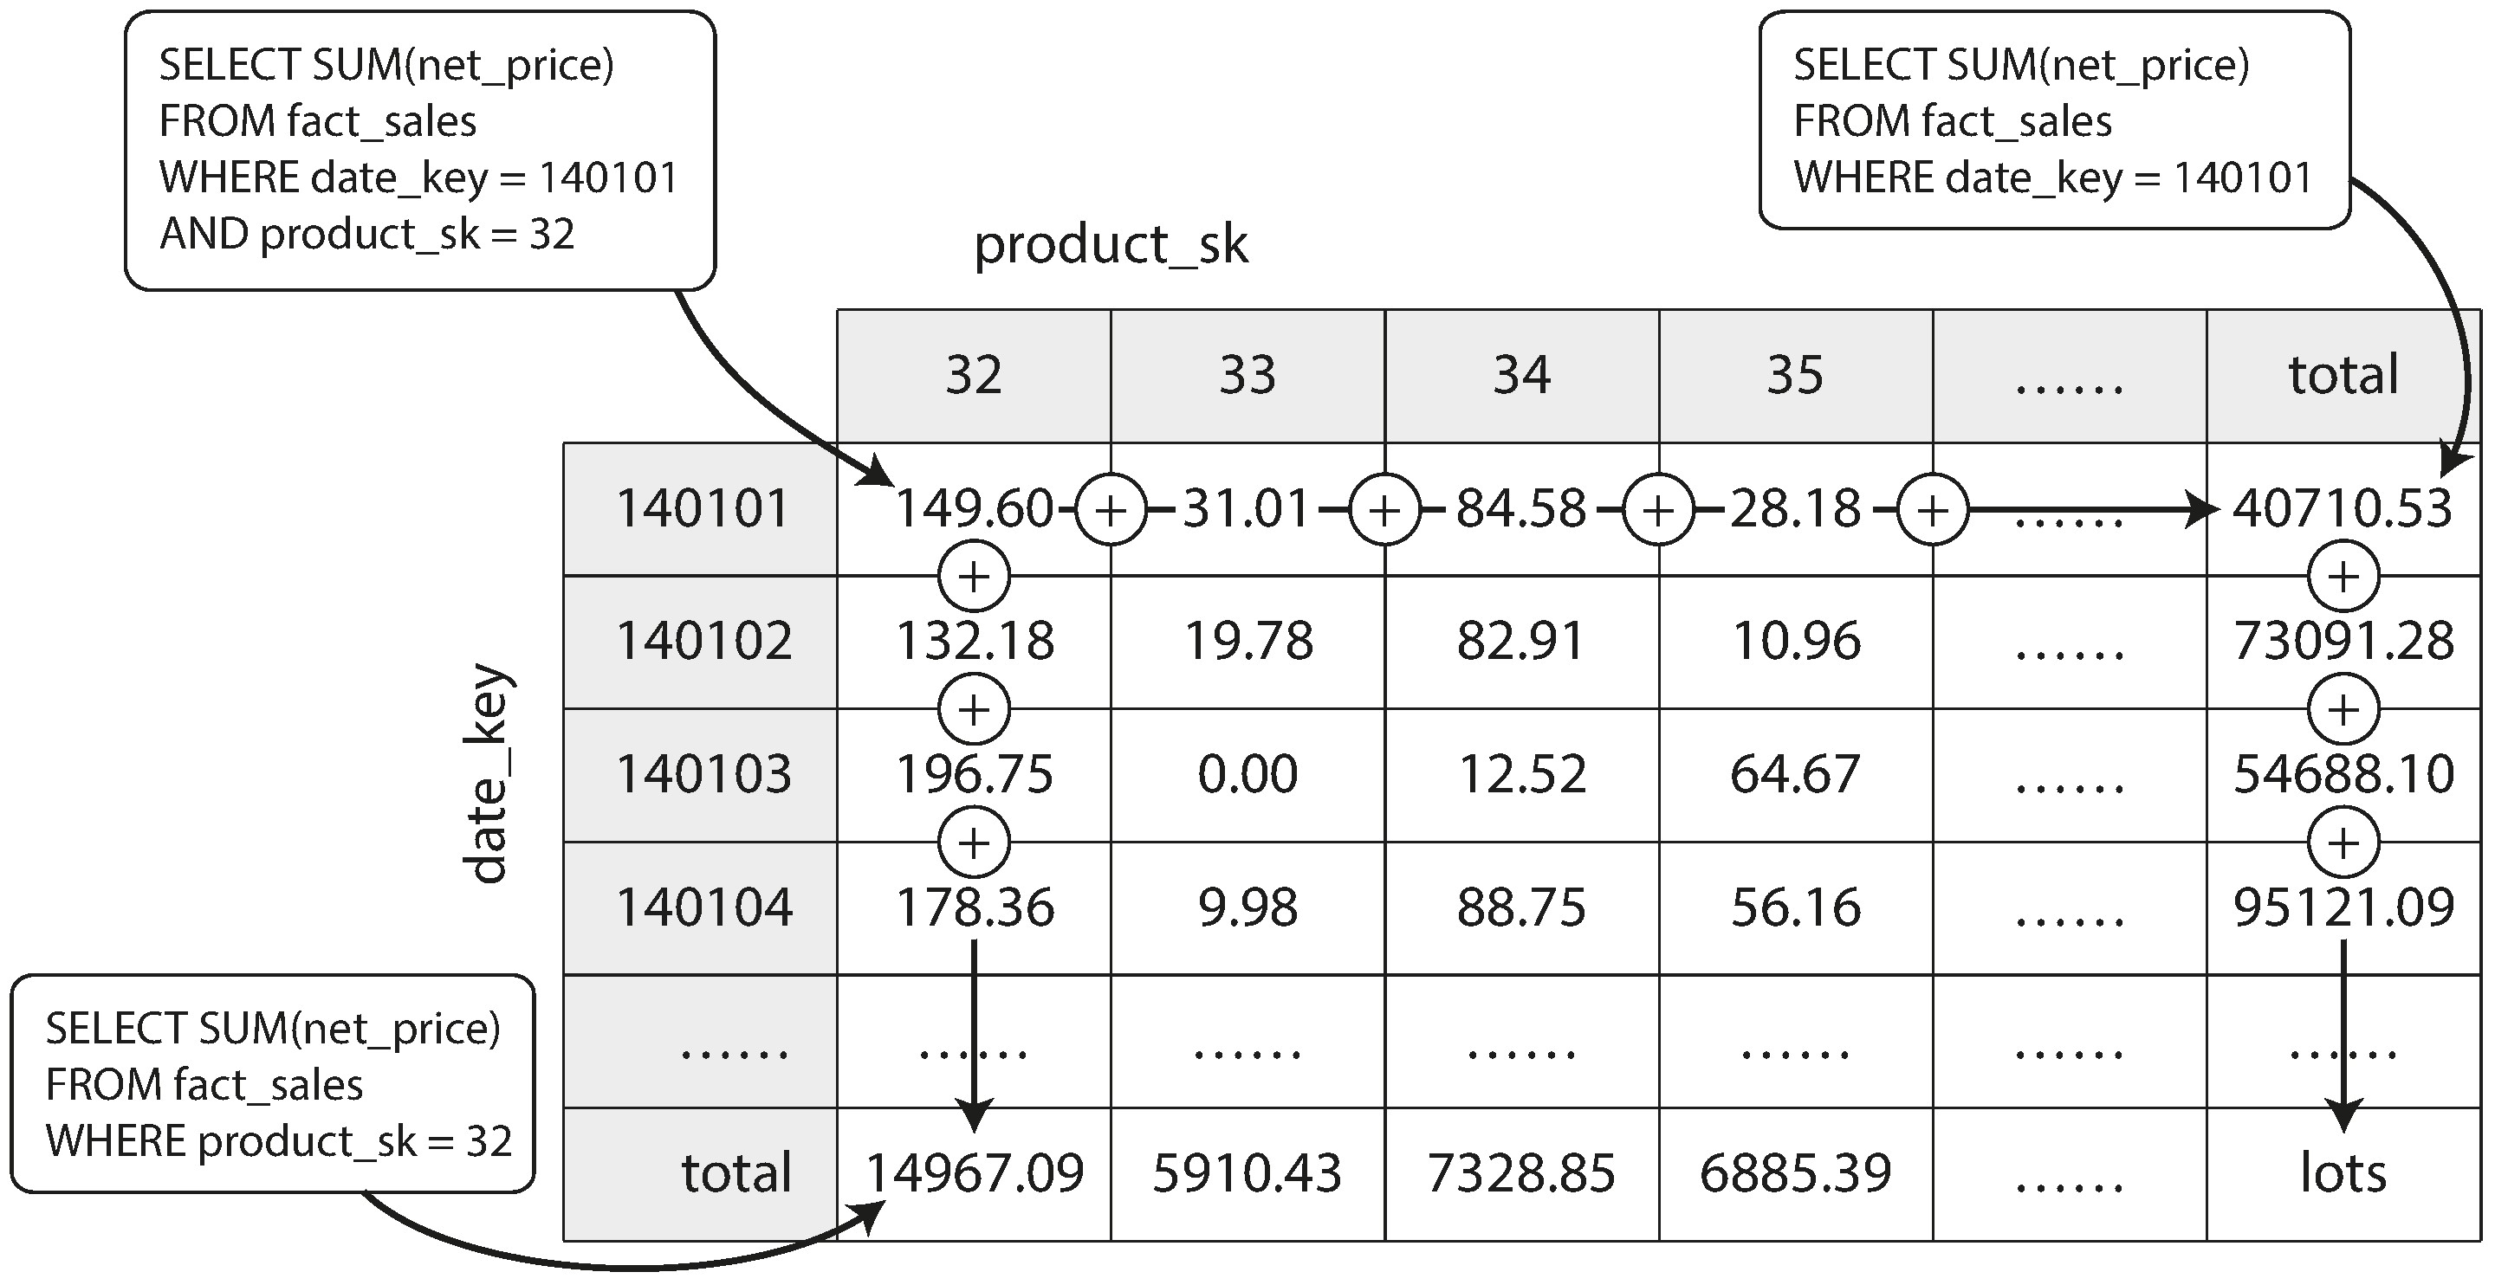
Data Cube in Data Warehouse

Slide 16
Replication

Slide 17
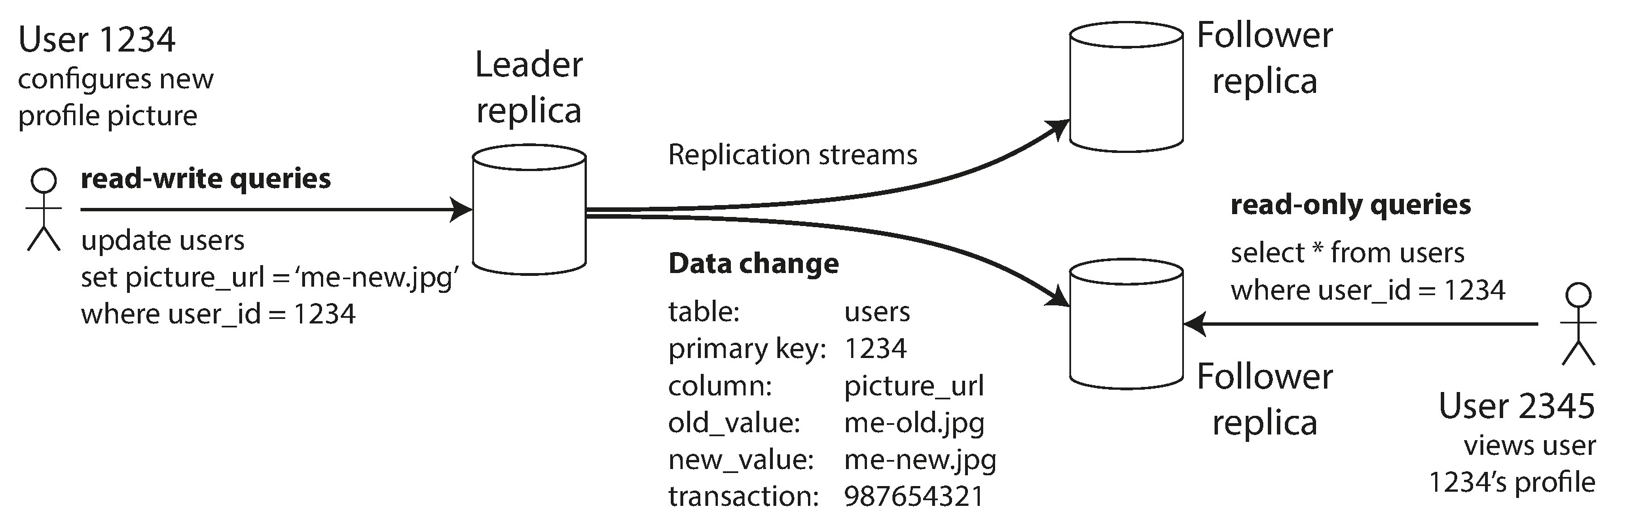
Leaders and Followers
One replica is designated the leader, which takes the writes from client, the others are followers, take the log from leader and update its local copy, i.e. applying all writes in the same order as the leader.
Either leader or followers can take the read request, but only the leader can take the writes.

Slide 18
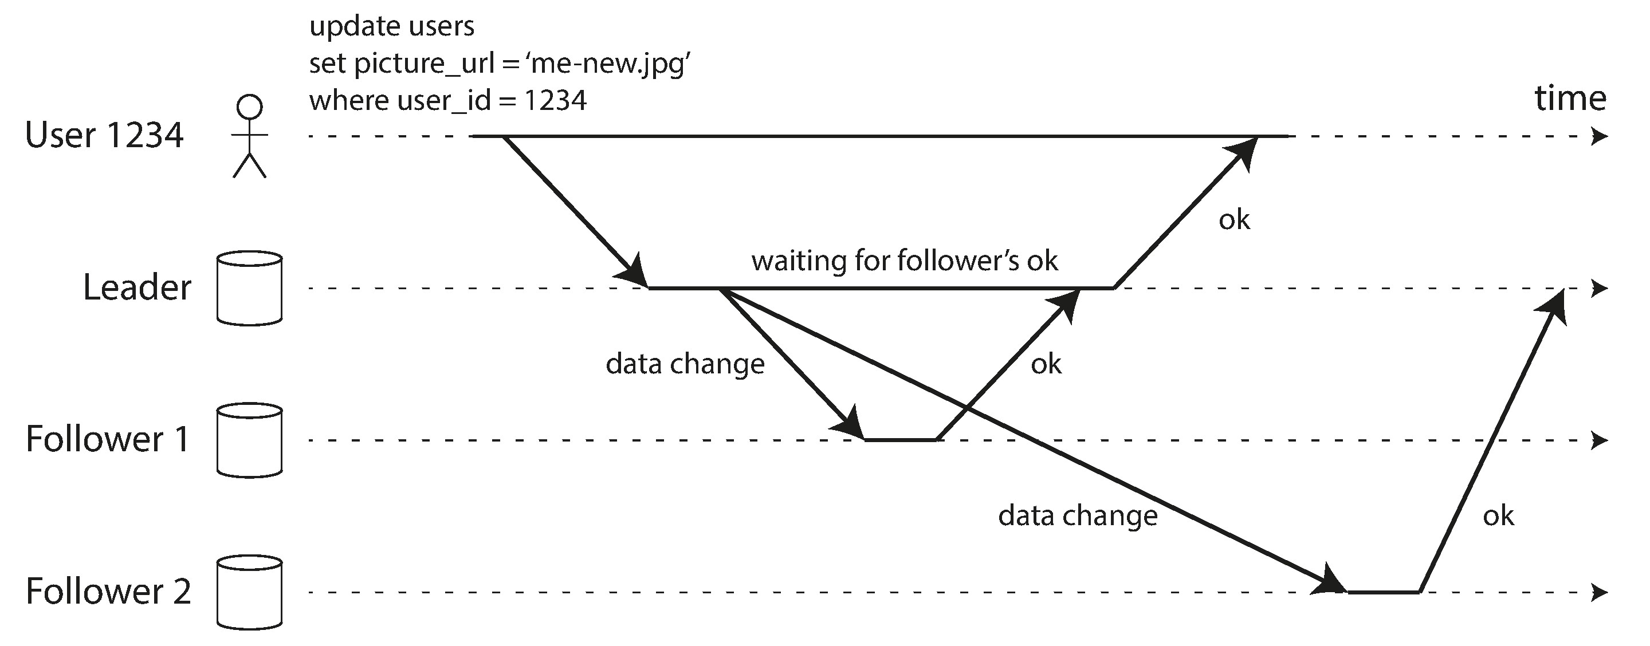
Synchronous Versus Asynchronous Replication

Slide 19
Setting Up New Followers
Take the snapshot of the leader
Copy the snapshot to the new follower node.
Catch up the changes in the log

Slide 20
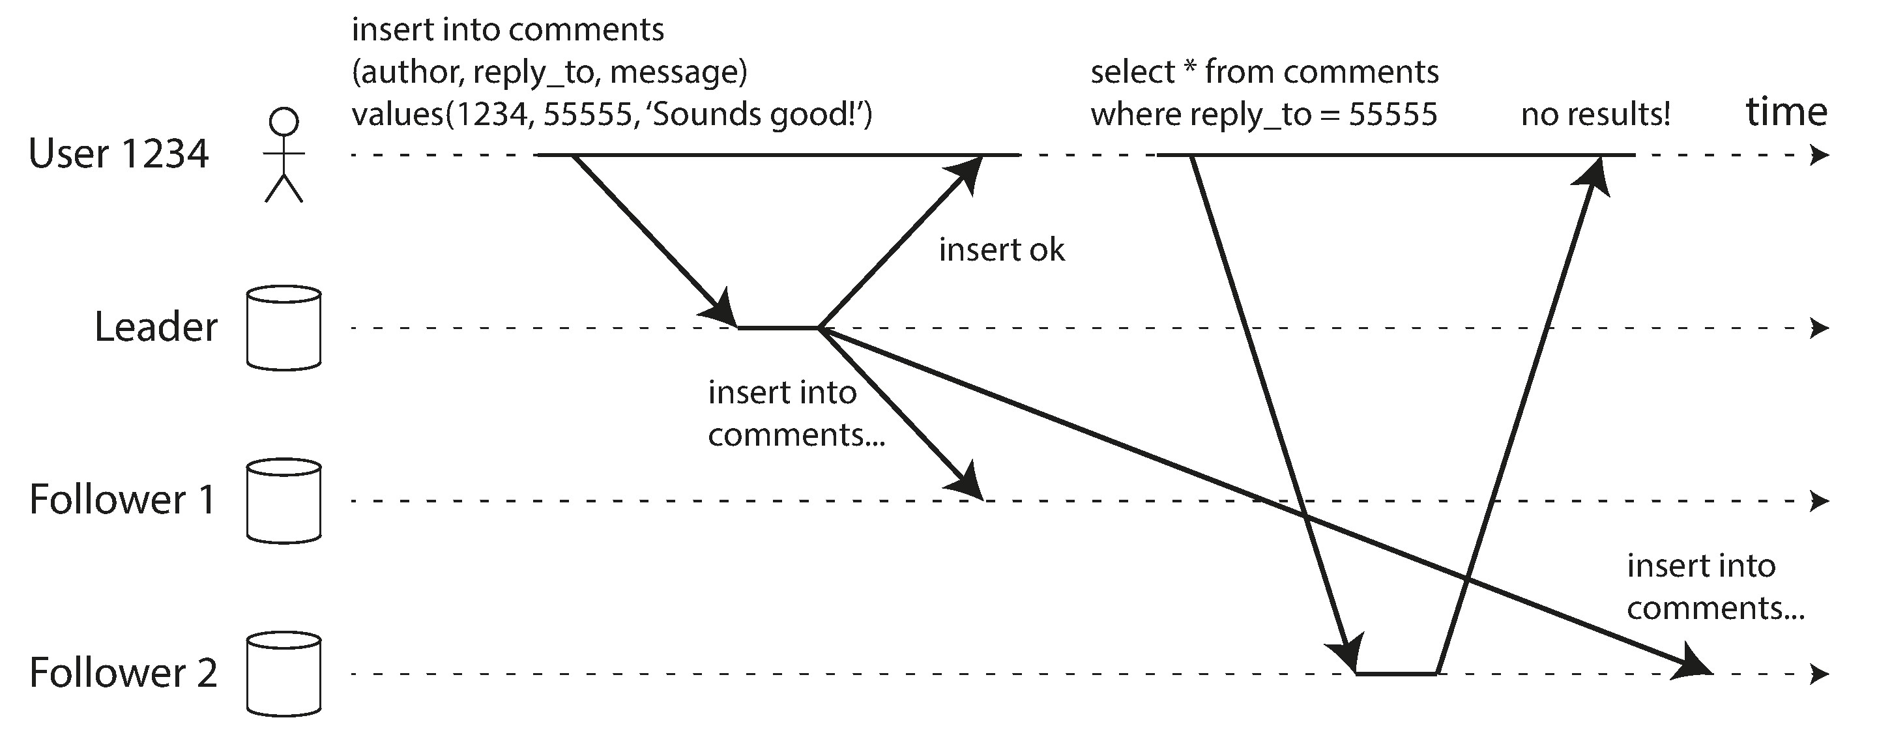
Problems with Replication Lag

Slide 21
Solutions for Replication Lag
Read on leaders
Reading Your Own Writes
Monotonic Reads
They will not read older data after having previously read newer data.
Consistent Prefix Reads
This guarantee says that if a sequence of writes happens in a certain order, then anyone reading those writes will see them appear in the same order
Transaction

Slide 22
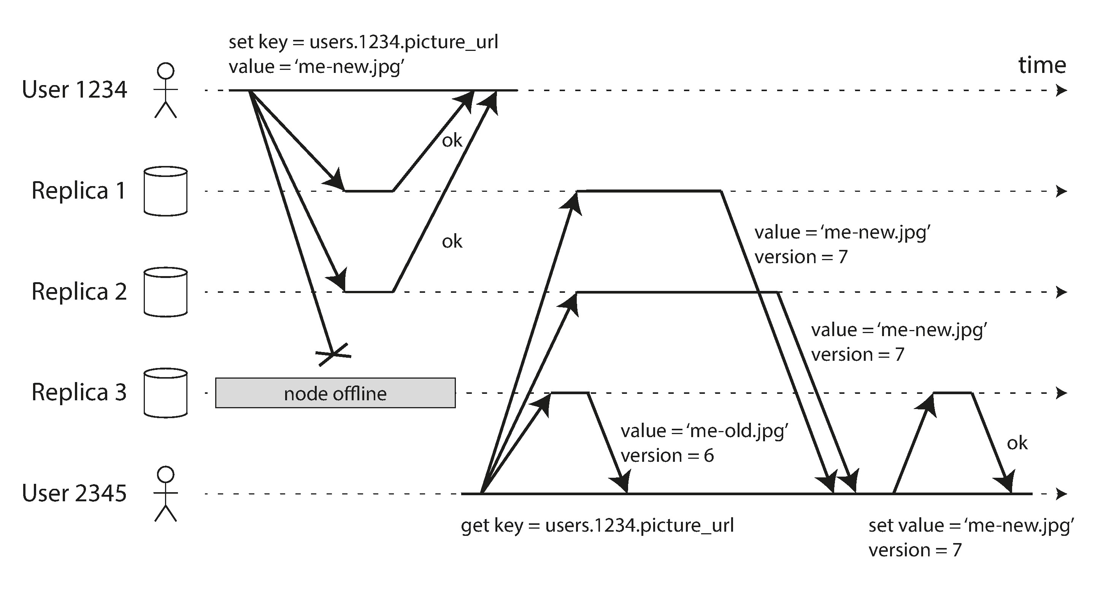
Leaderless Replication
Clients directly writes to and reads from multiple replicas.
Data has the version.

Slide 23
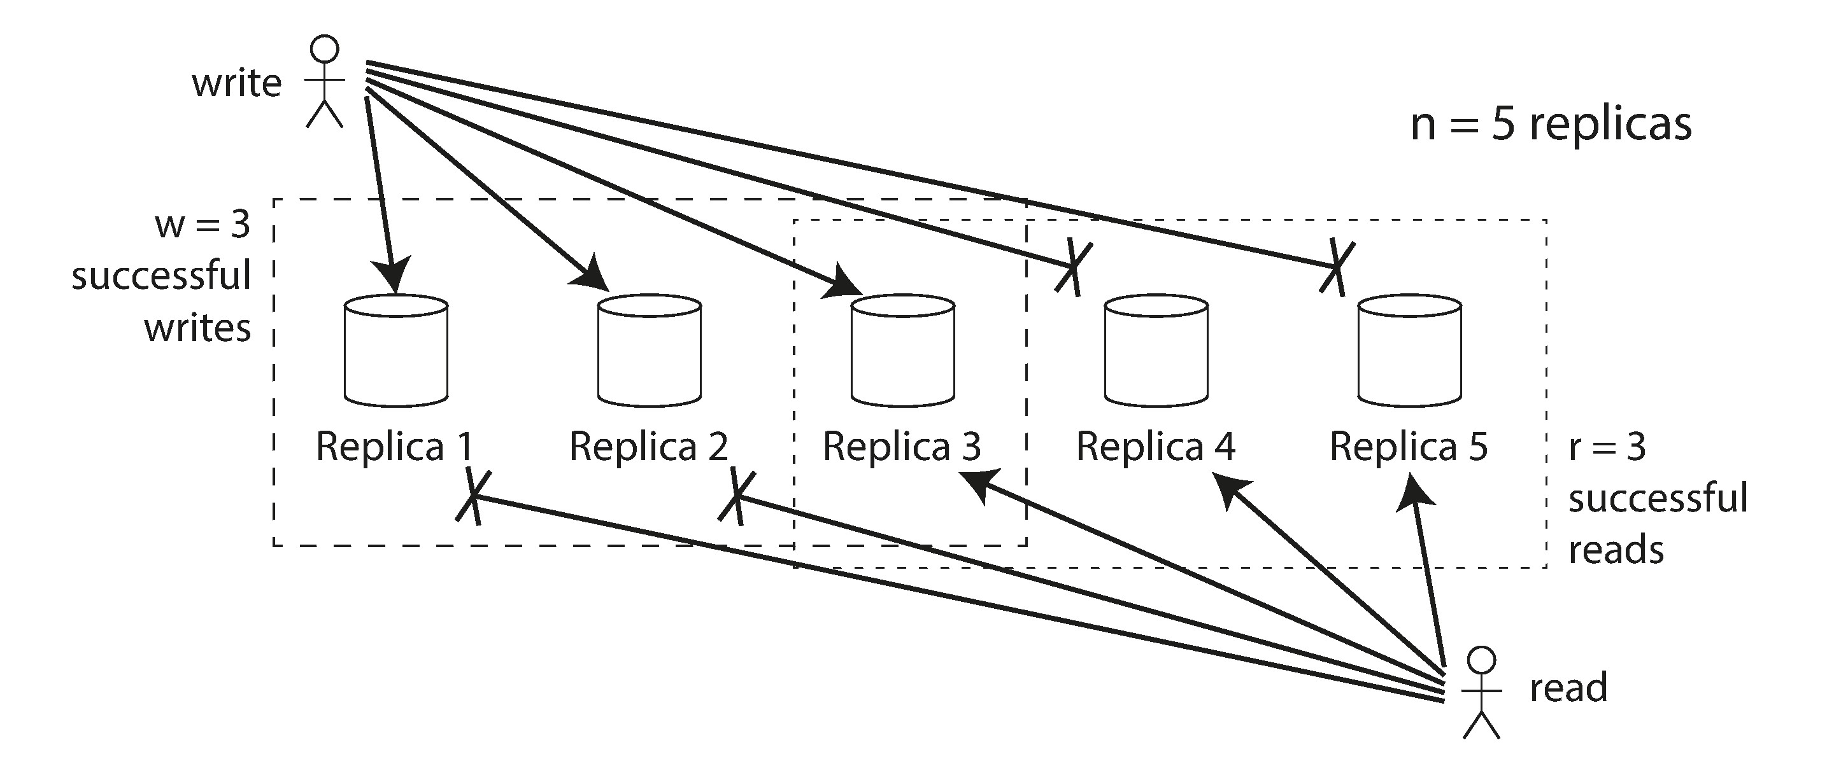
Quorums for reading and writing
R+ W > N means strong consistency.

Slide 24
Partition

Slide 25
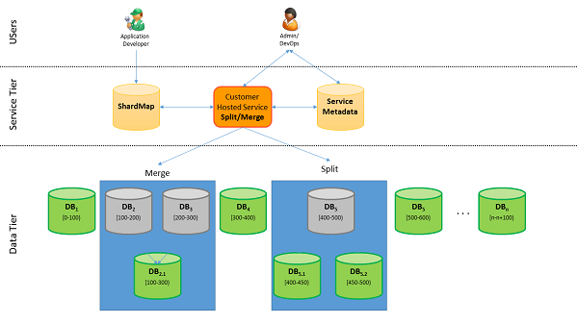
RDBMS Sharding

Slide 26
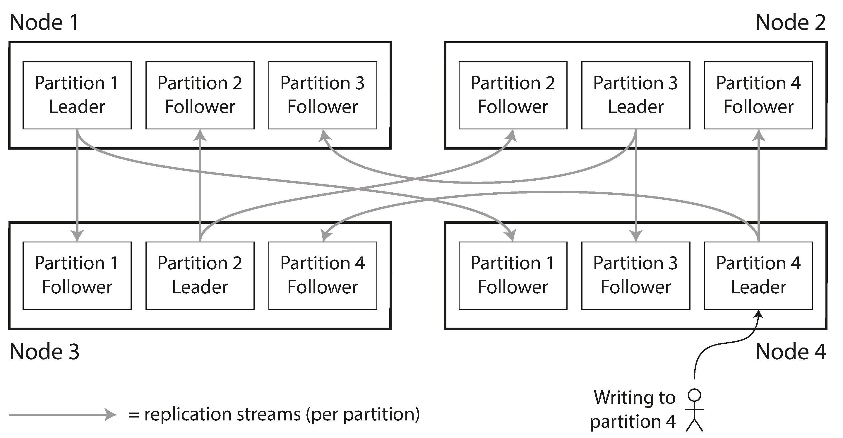
Partitioning and Replication

Slide 27
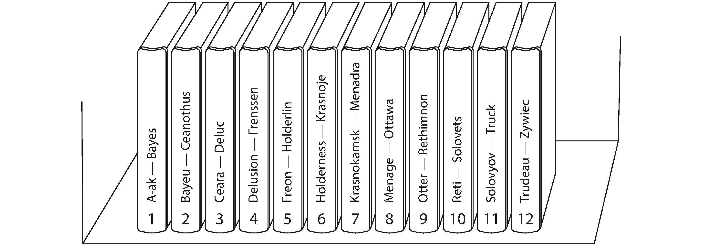
Partitioning by Key Range
Good for range query

Slide 28
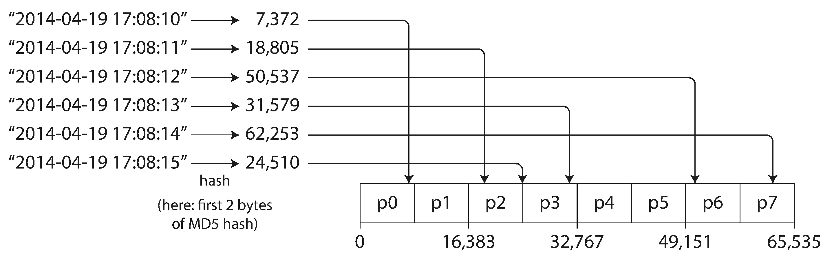
Partitioning by Hash of Key
Distribute evenly

Slide 29
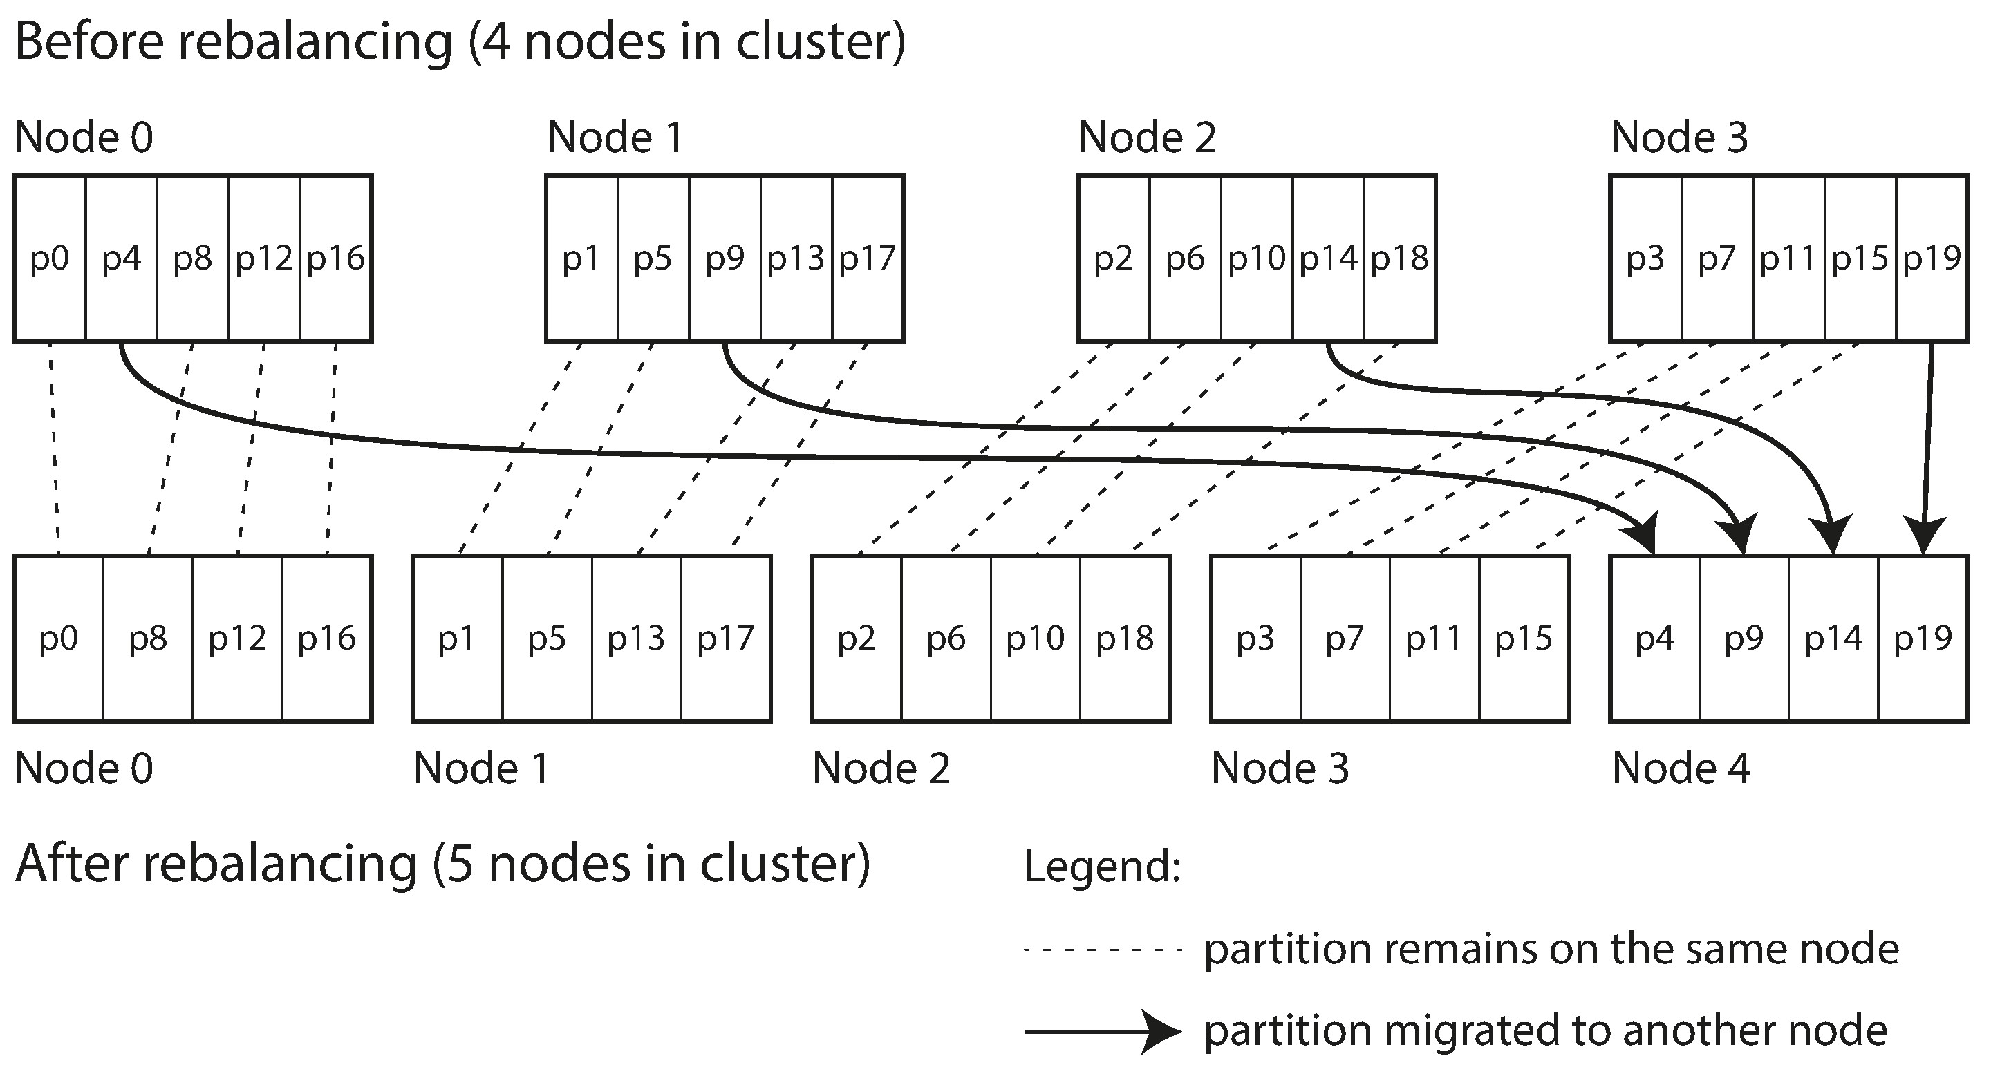
Rebalancing Partitions
Strategies for Rebalancing
How not to do it: hash mod N
Fixed number of partitions.
Dynamic partitioning
Partitioning proportionally to nodes

Slide 30
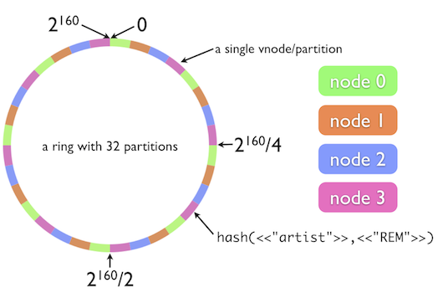
Consistent hash

Slide 31
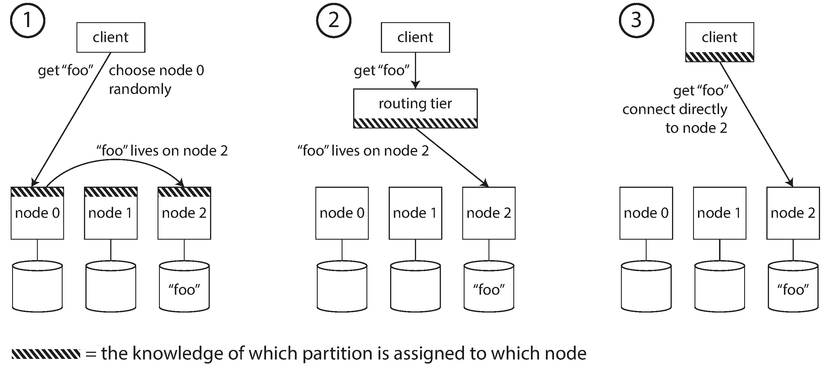
Request Routing

Slide 32
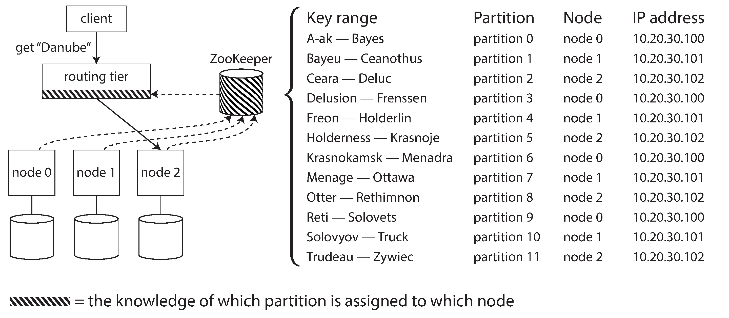
Request Routing – Zoo Keeper

Slide 33
Transaction

Slide 34
The Meaning of ACID
Atomicity
atomic refers to something that cannot be broken down into smaller parts.
Consistency
consistency is that you have certain statements about your data (invariants) that must always be true—for example, in an accounting system, credits and debits across all accounts must always be balanced.
Isolation
Several clients are reading or writing the same database records, you can run into concurrency problems (race conditions).
Durability
Durability is the promise that once a transaction has committed successfully, any data it has written will not be forgotten, even if there is a hardware fault or the database crashes

Slide 35
Isolation Levels
Weak Isolation Levels
Read Committed
Repeatable Read
Serialization

Slide 36
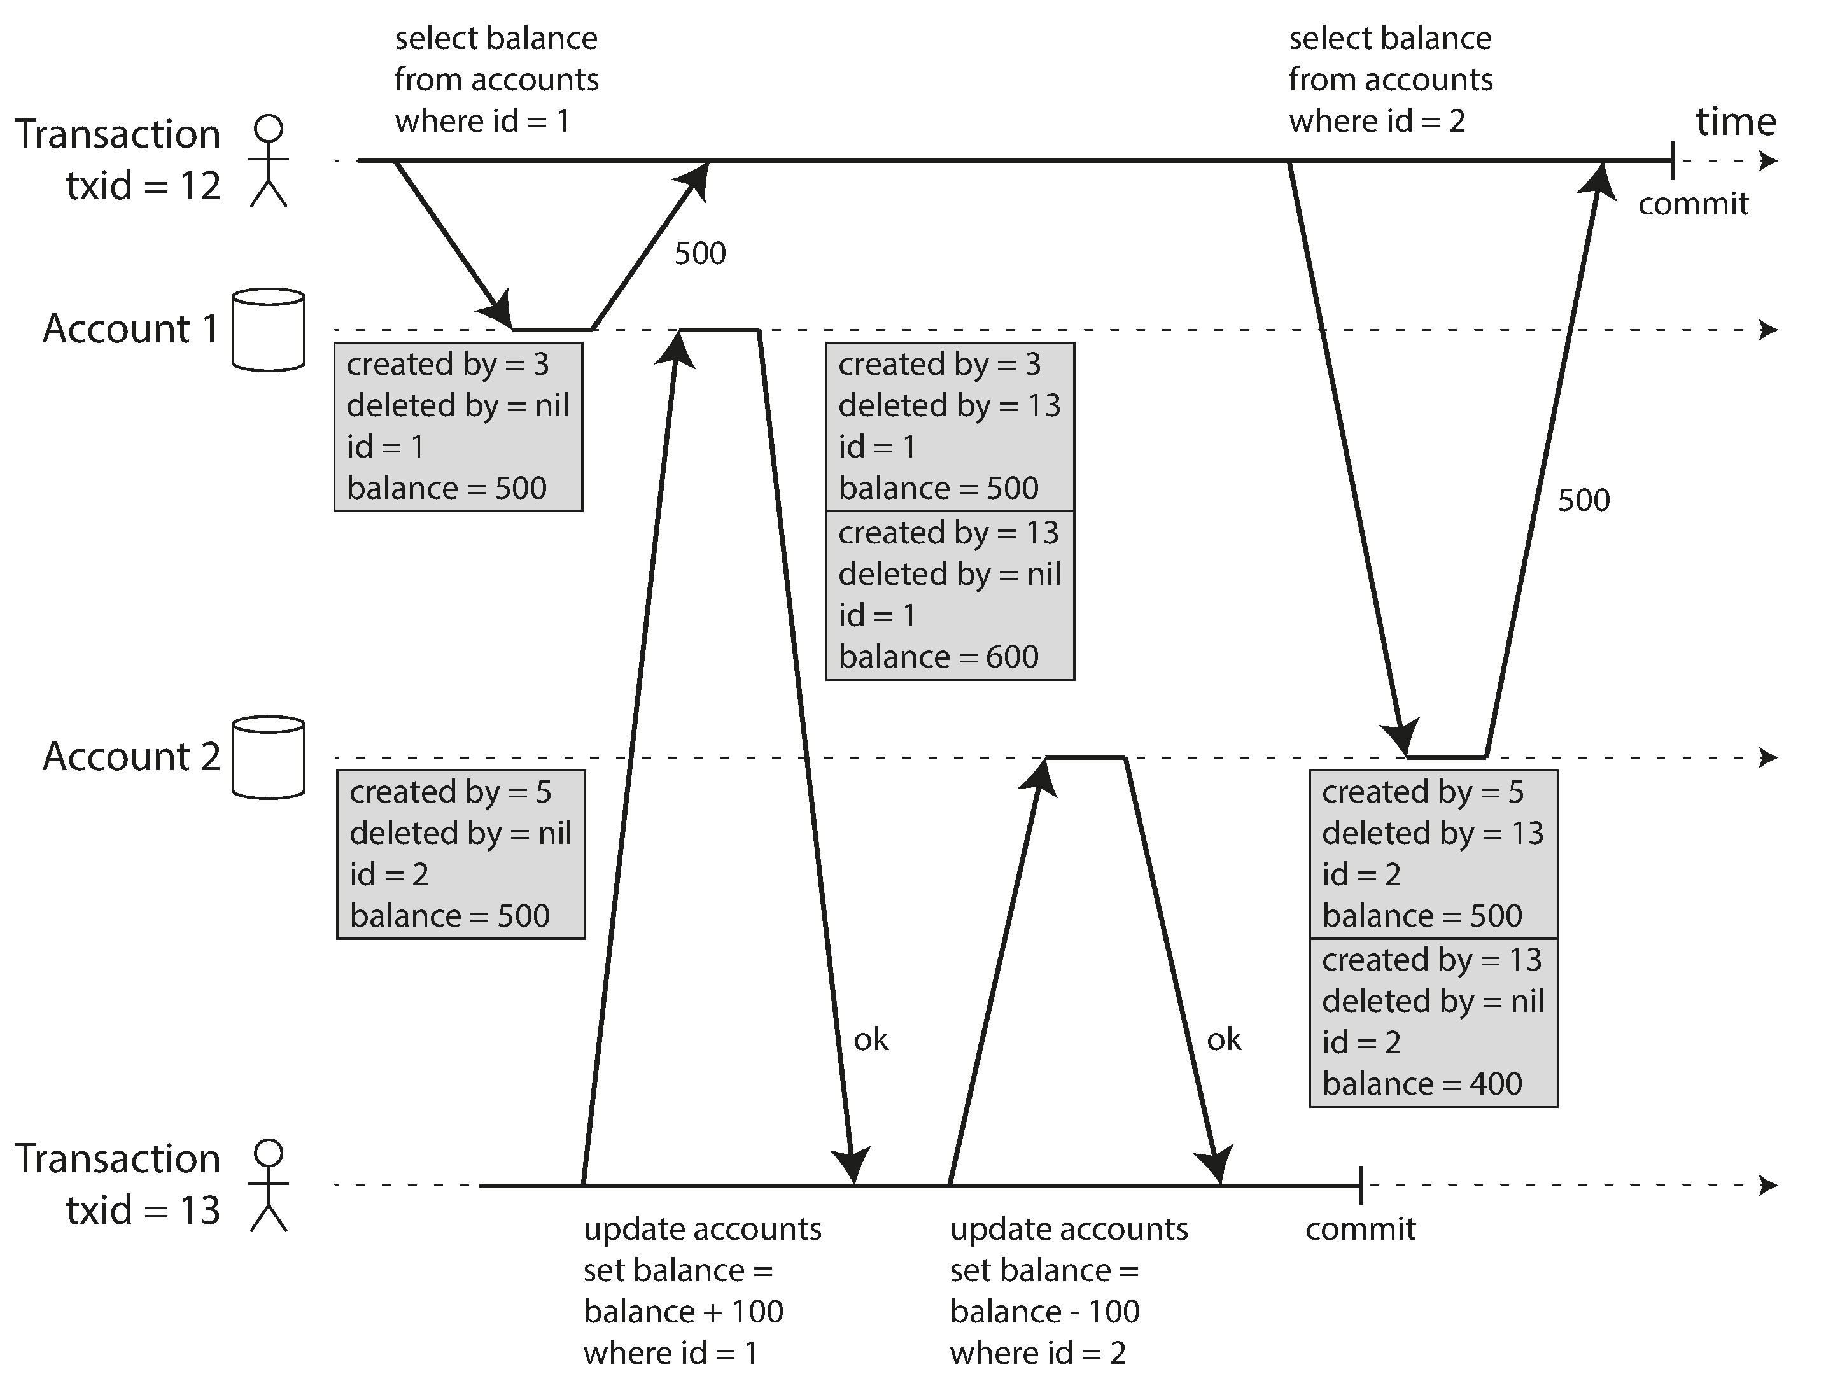
Snapshot Isolation and Repeatable Read
Implementing snapshot isolation using multi-version objects.

Slide 37
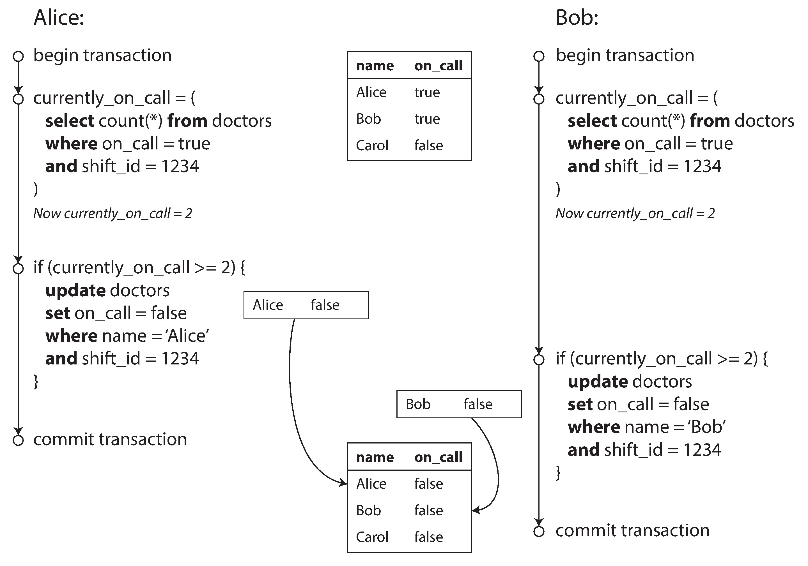
Write Skew and Phantoms

Slide 38
Two-Phase Locking (2PL)
Several transactions are allowed to concurrently read the same object as long as nobody is writing to it. But as soon as anyone wants to write (modify or delete) an object, exclusive access is required:
If transaction A has read an object and transaction B wants to write to that object, B must wait until A commits or aborts before it can continue. (This ensures that B can’t change the object unexpectedly behind A’s back.)
If transaction A has written an object and transaction B wants to read that object, B must wait until A commits or aborts before it can continue. (Reading an old version of the object, like in Figure 7-1, is not acceptable under 2PL.)
Clients starts from a shared lock, when it is going to write, it tries to acquire a exclusive lock
Predicate locks
Dead locks
Index-range locks
Notes:
If a transaction wants to read an object, it must first acquire the lock in shared mode. Several transactions are allowed to hold the lock in shared mode simultaneously, but if another transaction already has an exclusive lock on the object, these transactions must wait.
If a transaction wants to write to an object, it must first acquire the lock in exclusive mode. No other transaction may hold the lock at the same time (either in shared or in exclusive mode), so if there is any existing lock on the object, the transaction must wait.
If a transaction first reads and then writes an object, it may upgrade its shared lock to an exclusive lock. The upgrade works the same as getting an exclusive lock directly.
After a transaction has acquired the lock, it must continue to hold the lock until the end of the transaction (commit or abort). This is where the name “twophase” comes from: the first phase (while the transaction is executing) is when the locks are acquired, and the second phase (at the end of the transaction) is when all the locks are released.

Slide 39
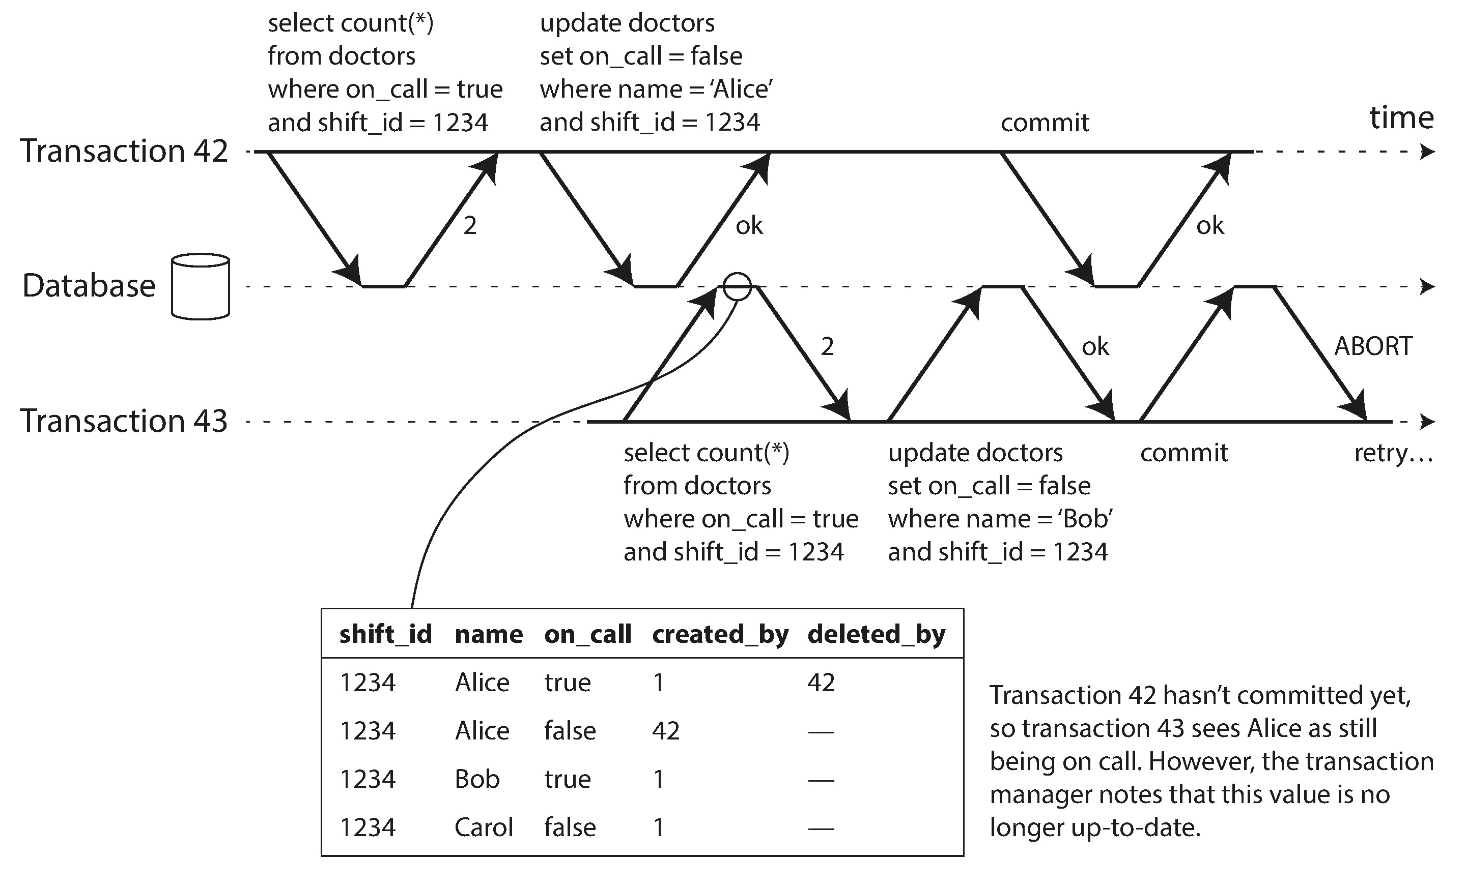
Optimistic concurrency control
Detecting stale MVCC reads
Notes:
If a transaction wants to read an object, it must first acquire the lock in shared mode. Several transactions are allowed to hold the lock in shared mode simultaneously, but if another transaction already has an exclusive lock on the object, these transactions must wait.
If a transaction wants to write to an object, it must first acquire the lock in exclusive mode. No other transaction may hold the lock at the same time (either in shared or in exclusive mode), so if there is any existing lock on the object, the transaction must wait.
If a transaction first reads and then writes an object, it may upgrade its shared lock to an exclusive lock. The upgrade works the same as getting an exclusive lock directly.
After a transaction has acquired the lock, it must continue to hold the lock until the end of the transaction (commit or abort). This is where the name “twophase” comes from: the first phase (while the transaction is executing) is when the locks are acquired, and the second phase (at the end of the transaction) is when all the locks are released.

Slide 40
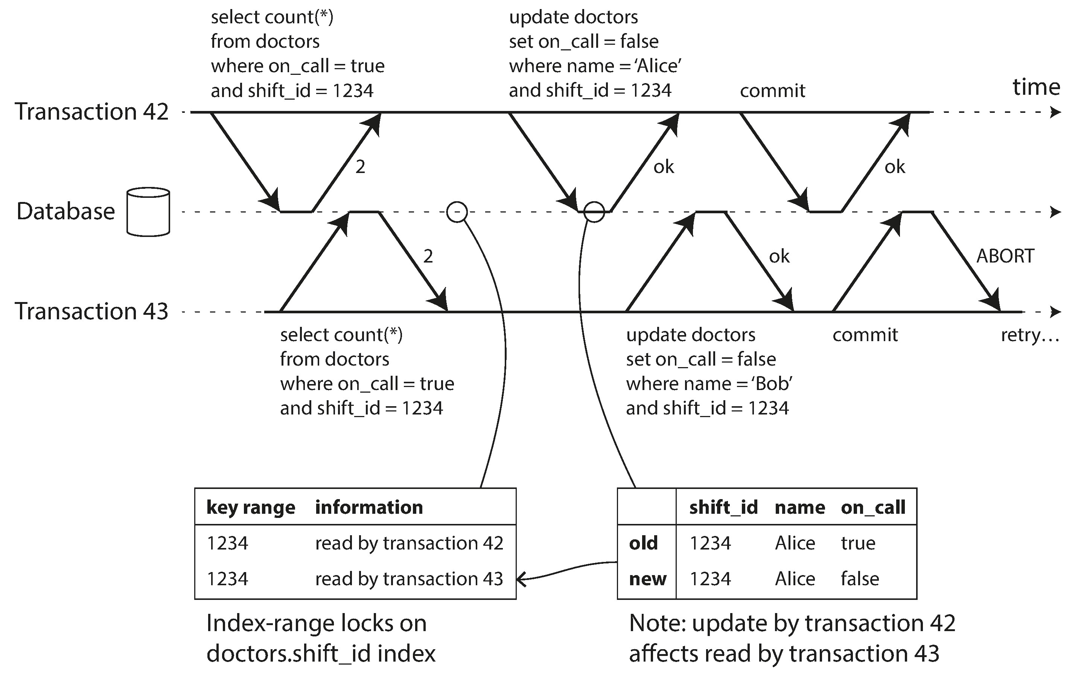
Serializable Snapshot Isolation
Detecting writes that affect prior reads
Notes:
If a transaction wants to read an object, it must first acquire the lock in shared mode. Several transactions are allowed to hold the lock in shared mode simultaneously, but if another transaction already has an exclusive lock on the object, these transactions must wait.
If a transaction wants to write to an object, it must first acquire the lock in exclusive mode. No other transaction may hold the lock at the same time (either in shared or in exclusive mode), so if there is any existing lock on the object, the transaction must wait.
If a transaction first reads and then writes an object, it may upgrade its shared lock to an exclusive lock. The upgrade works the same as getting an exclusive lock directly.
After a transaction has acquired the lock, it must continue to hold the lock until the end of the transaction (commit or abort). This is where the name “twophase” comes from: the first phase (while the transaction is executing) is when the locks are acquired, and the second phase (at the end of the transaction) is when all the locks are released.

Slide 41
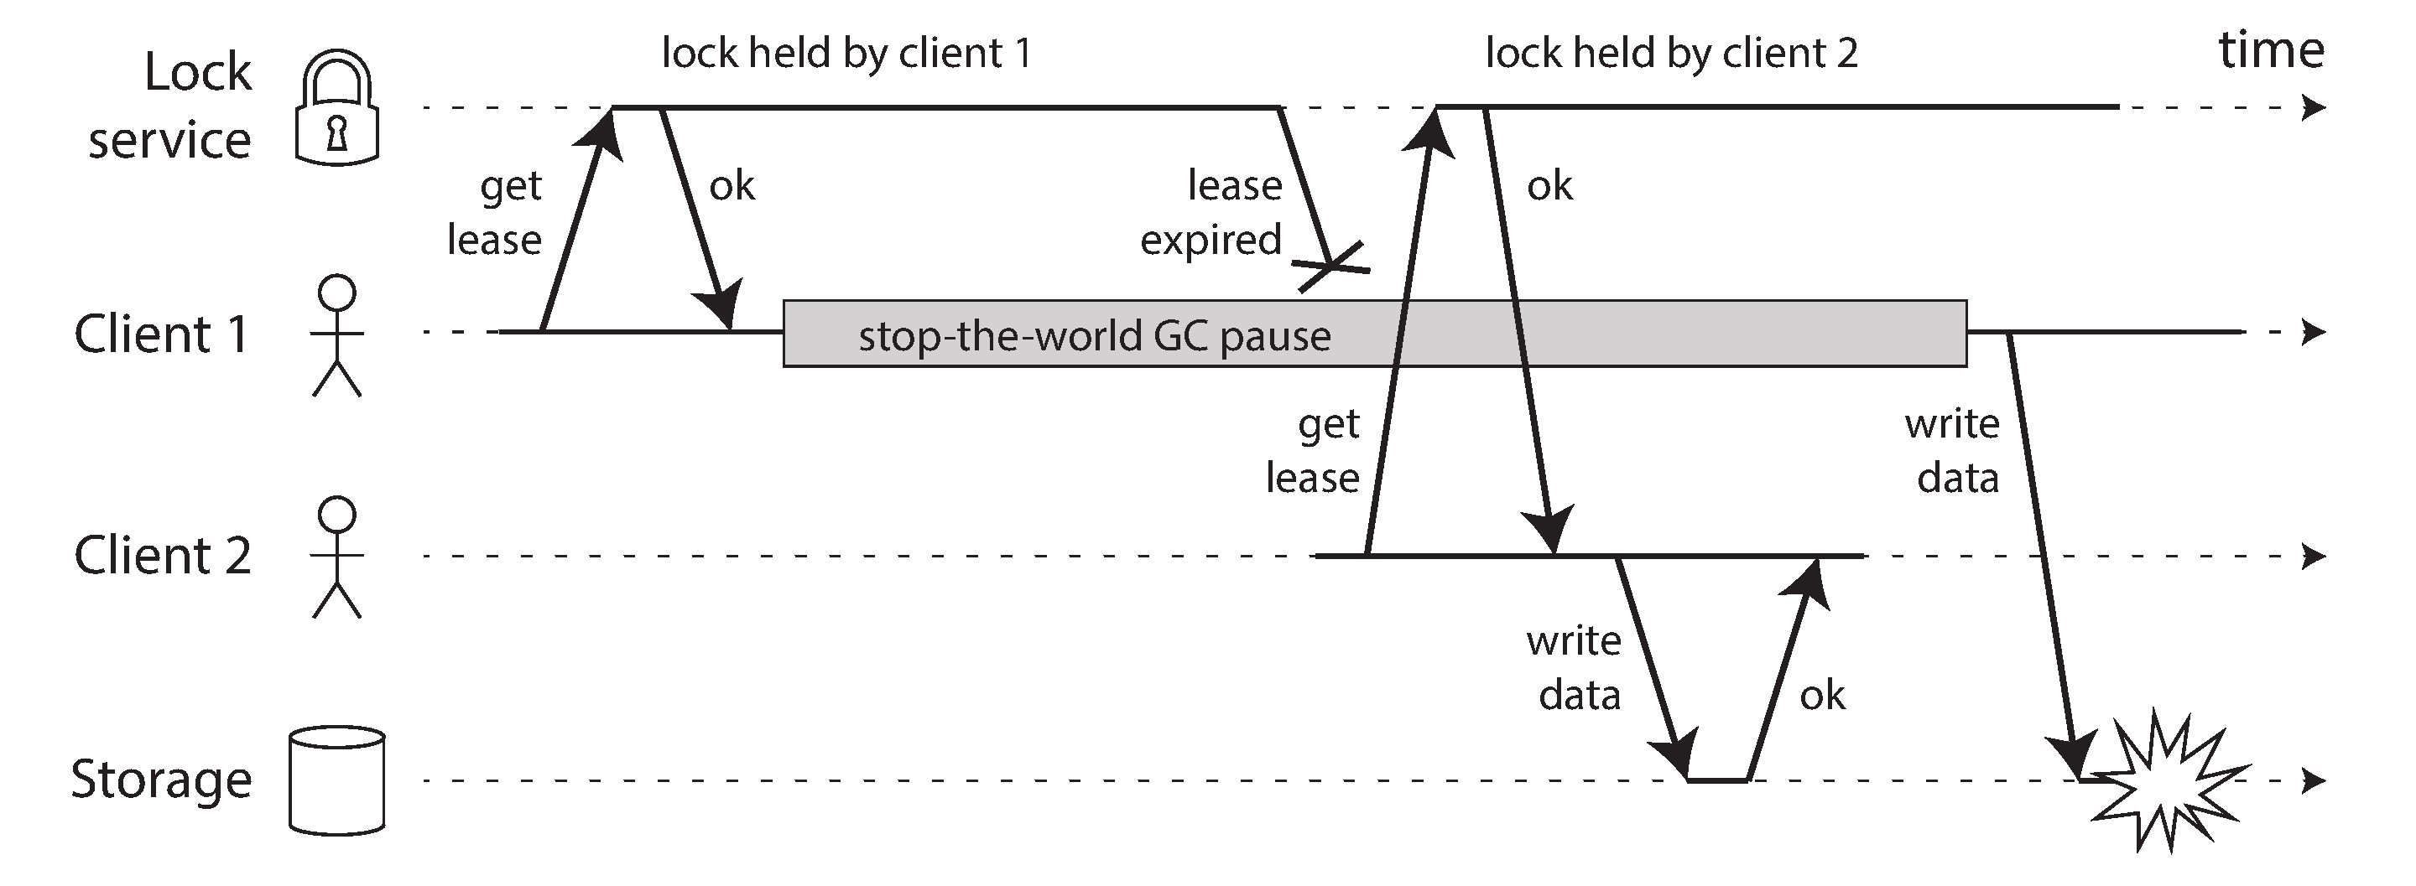
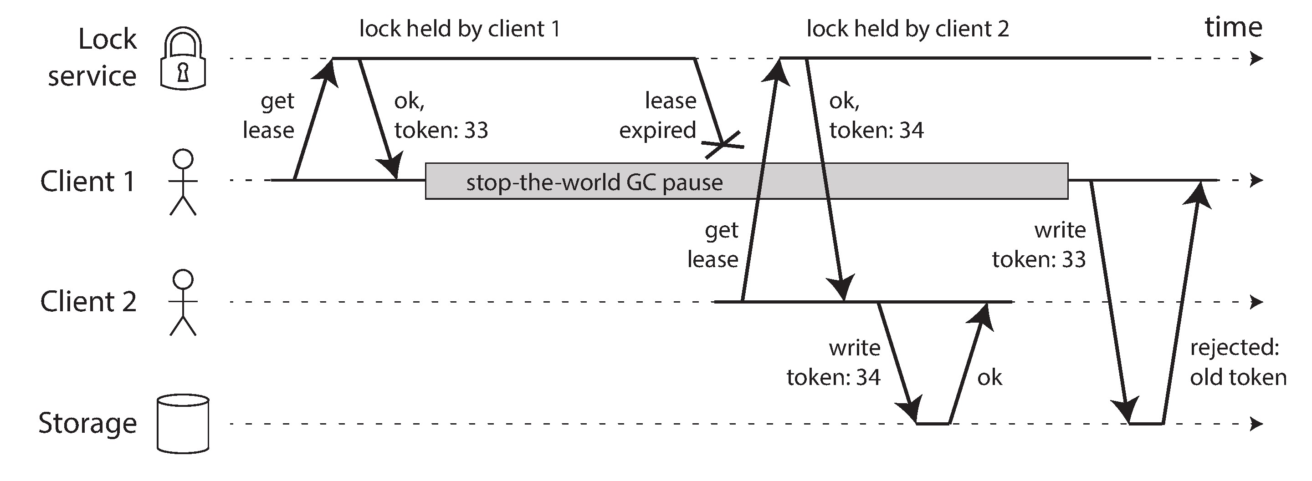
The leader lock and fencing token

Slide 42
Consistency and Consensus

Slide 43
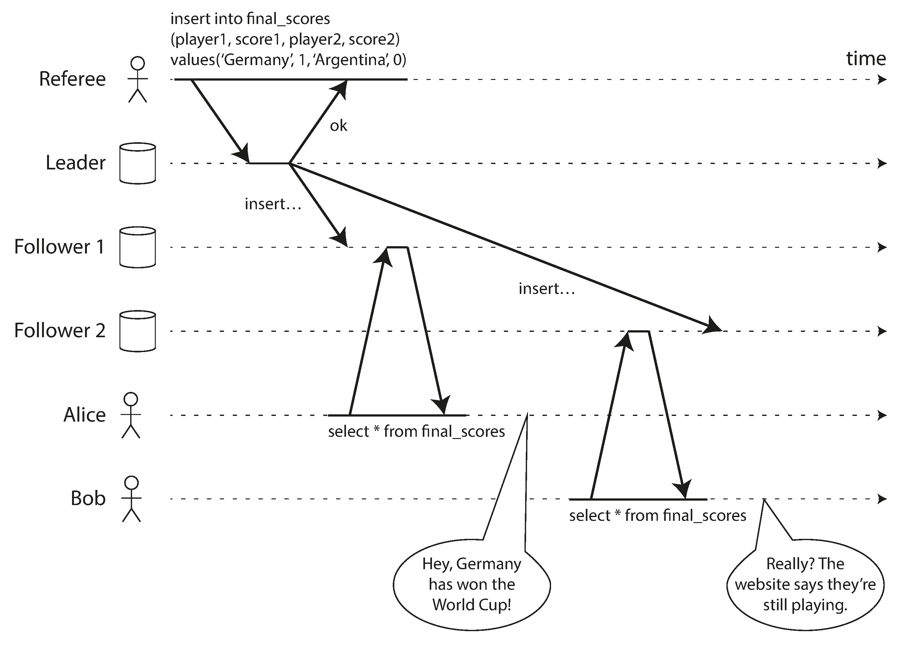
Linearizability Violation

Slide 44
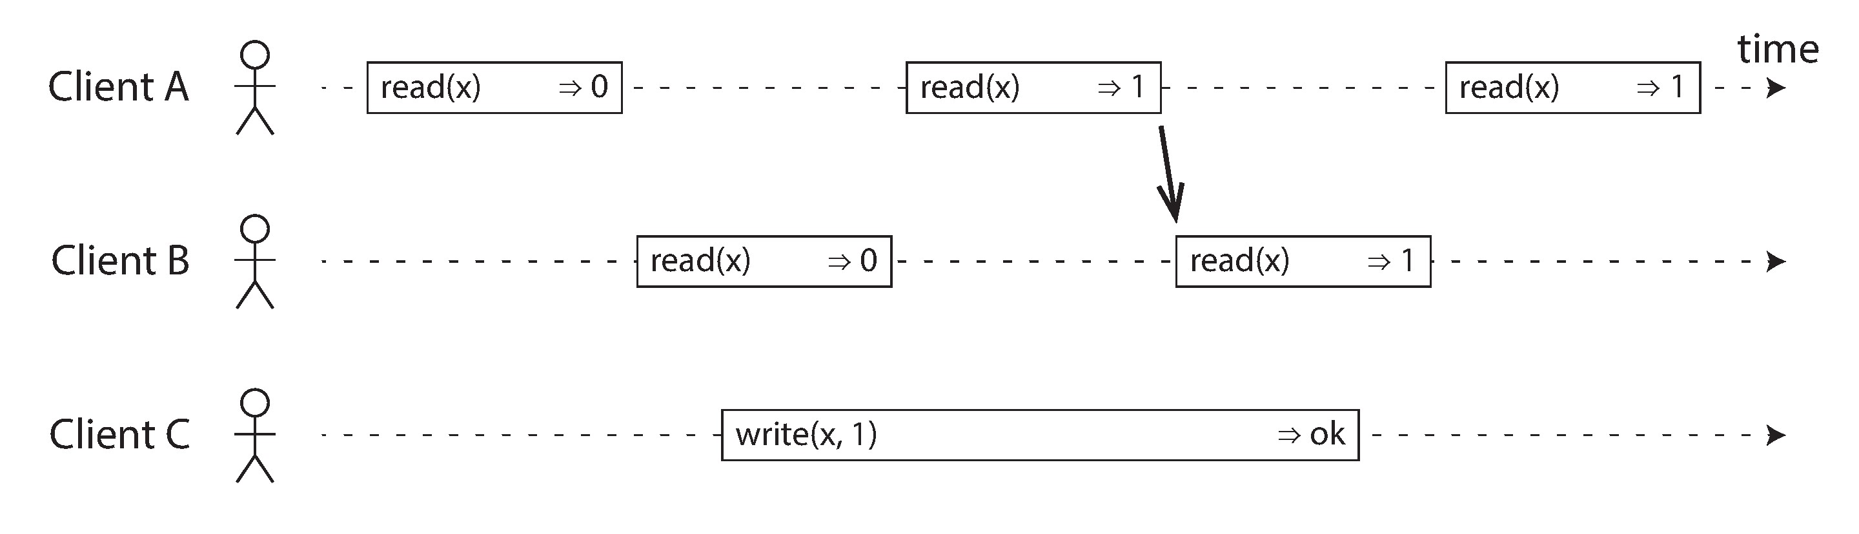
Linearizability
The basic idea behind linearizability is simple: to make a system appear as if there is only a single copy of the data.
In a linearizable system we imagine that there must be some point in time (between the start and end of the write operation) at which the value of x atomically flips from 0 to 1. Thus, if one client’s read returns the new value 1, all subsequent reads must also return the new value, even if the write operation has not yet completed.

Slide 45
Total Order Broadcast
Total order broadcast is usually described as a protocol for exchanging messages between nodes. Informally, it requires that two safety properties always be satisfied:
Reliable delivery
No messages are lost: if a message is delivered to one node, it is delivered to all nodes.
Totally ordered delivery
Messages are delivered to every node in the same order.

Slide 46
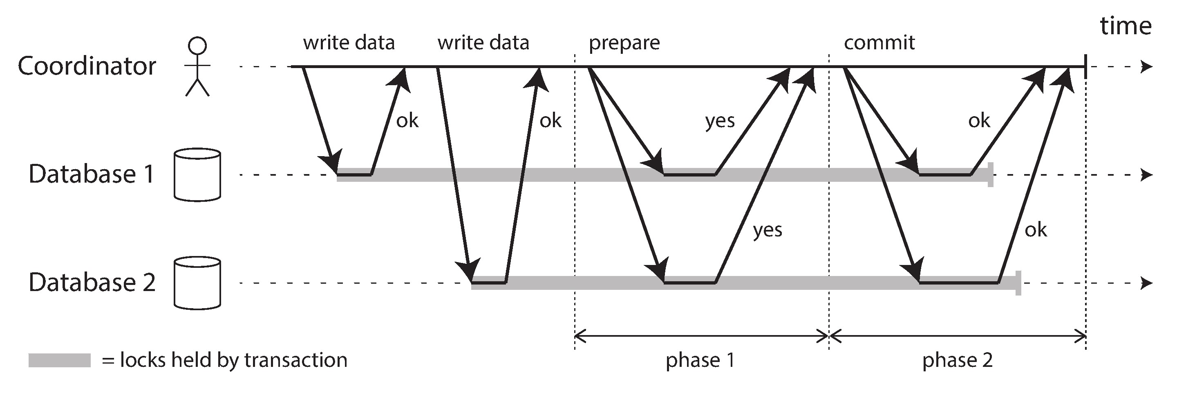
Distributed Transactions and Consensus
Atomic Commit and Two-Phase Commit (2PC)

Slide 47
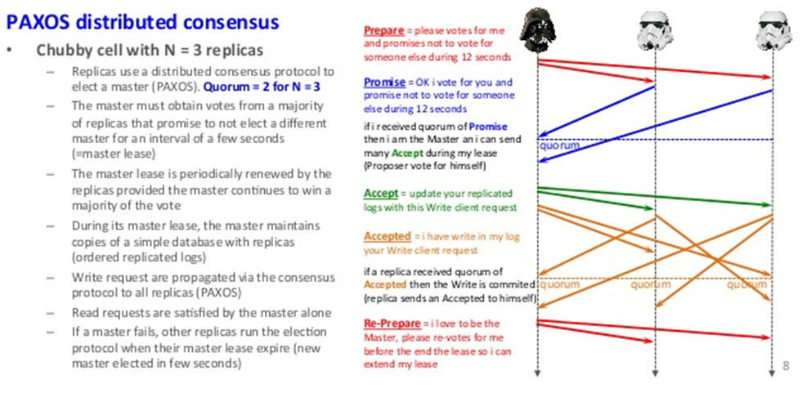
PAXOS

